Slide 1

A Project abstract presentation on Intelligent Adaptive Traffic Signal Control Using Computer Vision with Emergency Vehicle Priority
Presented by Batch DS 1-14
MANNURU TEJASWANI 22102A030059
PANDETI GURU SAI RAJU 22102A030089
BALIJE PALLI MEGHANA 22102A030010
NEELAPU HERAMBUDU 22102A030080
Data Science
Under the guidance of
Mr. P. Yogendra Prasad,
Assistant Professor,
Dept. of Data Science.
Program Head
Dr. K. Reddy Madhavi,
Professor & Head,
Dept. of Data Science.

Slide 2
Contents
Abstract
Introduction
Statement of the problem
Objectives
Motivation
Literature survey/ Rival Methods
Limitations of existing methods
Physical Model/ Network Model
Proposed System/method/Algorithm
Software and Hardware Requirements
Simulation Model
Performance Evaluation
Analysis of Experimental Data

Slide 3
Abstract
This project aims to design a Smart Traffic Light Control System that optimizes intersection signal timing using machine learning algorithms and vehicle counting techniques. Instead of relying on physical sensors, the system processes real-time video feeds to count vehicles at each lane of an intersection. By accurately determining vehicle density, the system dynamically adjusts signal phases and durations to accommodate changing traffic flows and minimize congestion. The core components include real-time video capture, vehicle detection and counting using computer vision algorithms, and adaptive signal control logic. The real-time analysis module processes video data to extract vehicle counts, which are then fed into machine learning models to predict short-term traffic demand. By coordinating signal timings across adjacent intersections, the system ensures smoother traffic flow, reduces unnecessary delays, and minimizes vehicle idling time. Beyond congestion reduction, this approach improves road safety, lowers emissions, and enhances overall transportation efficiency.
Keywords: Predictive Traffic Analysis, Smart Traffic Light Control, Real-Time Traffic Management, Vehicle Detection, Computer Vision, Adaptive Signal Control, Traffic Congestion Reduction.

Slide 4
Introduction
Traffic congestion has reached critical levels due to rapid urbanization and rising vehicle usage.
Traditional fixed-time signals are inadequate for managing dynamic traffic flows.
Real-time video analysis counts vehicles at intersections to cost-effective, accurate, no need for expensive infrastructure.
Predictive analytics anticipates traffic patterns to optimizes signals before congestion occurs.
Emergency vehicle priority ensures faster ambulance and fire service response.
Reduced idle time & fuel consumption to lowers carbon emissions, improves air quality.
Cost-effective and scalable to adaptable to different urban environments.
Supports smart cities to foundation for future autonomous and connected vehicle ecosystems.

Slide 5
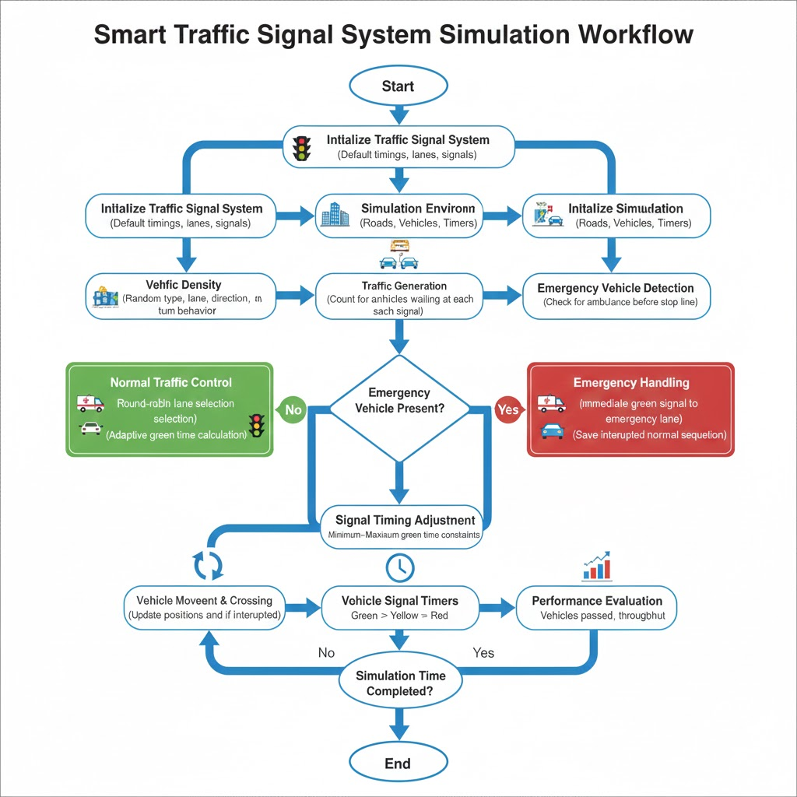

Slide 6
Statement of the problem
An intelligent system that leverages AI, real-time data, and predictive analytics to dynamically control traffic signals, reduce congestion, prioritize emergency vehicles, lower fuel consumption, and create a scalable solution for smart and sustainable urban mobility.
Existing traffic systems rely on static signal timings and limited prediction models.
Fail to capture spacio-temporal dependencies.
Lack adaptability to external factors (weather, holidays).
Struggle with scalability in multi-intersection city networks.
These challenges demand an intelligent, adaptive framework for smart city traffic.

Slide 7
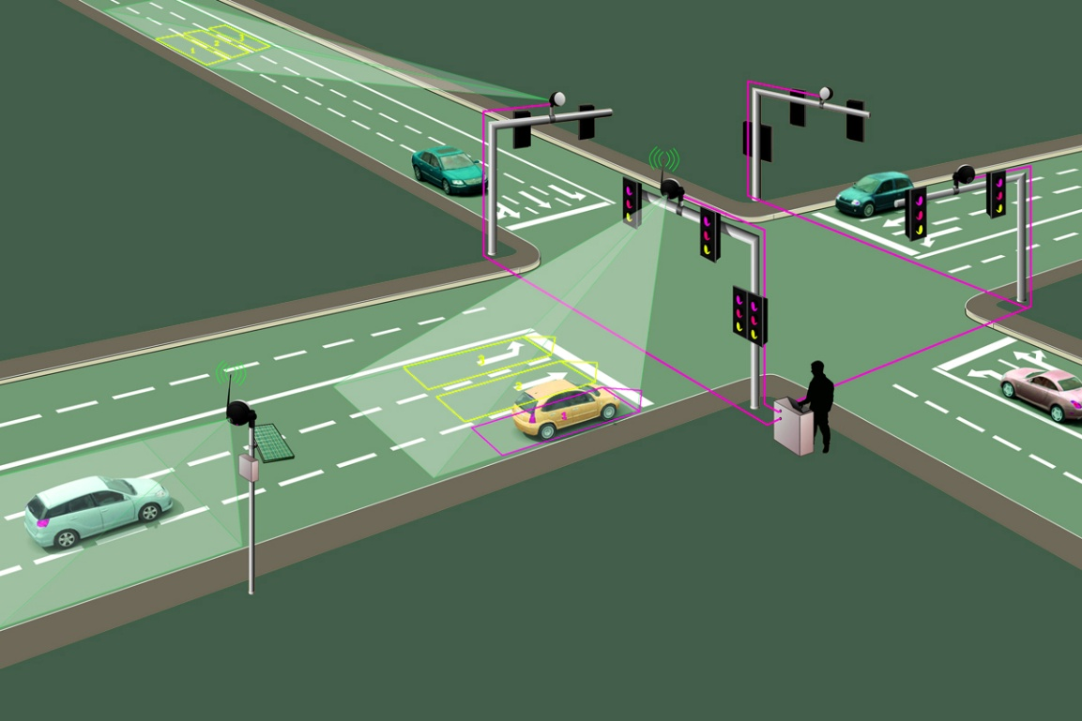
Motivation
Traffic congestion affects urban mobility, fuel efficiency, and environment.
Traditional systems fail during peak hours or
unexpected events.
An AI-driven solution ensures:
Better urban mobility
Sustainability
Smart city development alignment

Slide 8
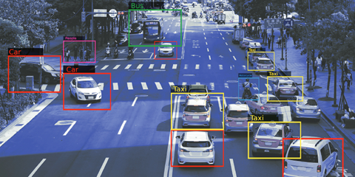
Objectives
To design and develop a four-way intelligent traffic signal simulation using Python and Pygame that models real-world traffic behavior.
To simulate multiple vehicle types (car, bus, truck, bike,
rickshaw, and ambulance) with lane-based movement,
stopping rules, and turning logic.
To implement adaptive traffic signal control by dynamically
calculating green signal duration based on vehicle density
and lane occupancy.
To prioritize emergency vehicles (ambulances) by detecting their presence, interrupting the normal signal sequence, and allocating a dedicated green signal for safe and fast passage.
To integrate a YOLO-based vehicle detection module for identifying vehicles from images, supporting real-time traffic density estimation.

Slide 9
Literature Survey
Traditional traffic signal systems use fixed-time signal control, where green durations are pre-defined based on historical averages.
Actuated traffic systems use loop detectors or sensors to detect vehicle presence but lack prediction capability.
Image-processing-based systems detect vehicles using basic computer vision techniques without adaptive scheduling.
AI-based approaches include:
Machine learning for traffic density estimation
Reinforcement learning for adaptive signal control
Deep learning models for traffic flow prediction
Most existing methods focus on either vehicle detection OR signal control, not both in an integrated manner.
Some recent systems use IOT-based smart signals, but they depend heavily on continuous internet connectivity.
Centralized traffic management approaches may cause single-point failure if the control server crashes.

Slide 10
Limitations of Existing Methods
Fixed-time signals cannot adapt to real-time traffic variations.
Sensor-based systems require costly infrastructure and frequent maintenance.
Many systems do not prioritize emergency vehicles, causing delays.
Existing AI models:
Require large datasets
Are computationally expensive
Are difficult to deploy in real-time environments
Lack of fairness: some lanes may experience starvation during peak hours.
Poor scalability for multi-lane urban intersections.
Most systems lack real-time visualization, making monitoring and debugging difficult.
Emergency vehicle handling is often manual or rule-based, leading to delayed response.

Slide 11
Physical Model
The system models a four-way road intersection with multiple lanes.
Each direction contains:
Two regular lanes, One dedicated bike/light vehicle lane
Vehicles are represented as moving agents with:
1) Speed
2) Direction
Traffic signals operate in red, yellow, and green phases.
Emergency vehicles (ambulance) are detected and given priority access.
Communication between components occurs through a central signal controller.
The intersection is modeled using a centralized control unit that manages all signals.
Vehicle movement follows lane-based constraints, mimicking real-world road behavior.

Slide 12
Proposed System
The proposed system uses a simulation-based adaptive traffic signal controller.
Vehicle density is dynamically calculated by counting vehicles waiting at each signal.
Green signal duration is computed based on:
Lane density, Minimum and maximum time constraints
An emergency detection mechanism identifies ambulances before the stop line.
Emergency lanes are served immediately while preserving fairness.
After emergency handling, the system returns to normal round-robin scheduling.
The system ensures:
Reduced waiting time
Emergency vehicle prioritization
The algorithm dynamically switches between normal mode and emergency mode.
A queue-based mechanism ensures orderly handling of multiple emergency requests.

Slide 13
Software and Hardware Requirements
Software Requirements
Hardware Requirements
Pygame (for simulation and visualization)
Standard Python libraries:
threading
math
random
Operating System:
Windows / Linux / macOS
Minimum 4 GB RAM
Intel i3 or higher processor
Standard display for visualization

Slide 14
Simulation Model
A real-time traffic simulation is implemented using Pygame.
Vehicles are generated randomly with probabilistic distribution.
Each simulation run lasts 300 seconds.
Signal controller operates continuously with:
Adaptive green timing
Emergency interruption handling
Vehicles follow:
Stop-line constraints
Safe inter-vehicle distance
Turning rules
The simulation visually represents:
Vehicle movement
Signal state changes
Traffic flow behavior

Slide 15
Performance Evaluation
The system performance is evaluated based on:
Total number of vehicles crossed per lane
Average waiting time reduction
Emergency vehicle clearance time
Fairness in signal allocation
Signal utilization efficiency
The System maintains stable throughput even during emergency interruptions.
Observed improvements:
Reduced congestion during high-density traffic
Faster emergency vehicle passage
Balanced service among all lanes

Slide 16
Analysis of Experimental Data
Lane-wise vehicle count data is recorded at the end of simulation.
Traffic throughput is measured as:
Vehicles passed per unit time
Emergency scenarios show:
Immediate signal switching
No starvation of other lanes
Results confirm:
Stable operation for full simulation duration
Effective adaptive signal timing
Robust emergency handling logicExperimental results show consistent lane utilization over the simulation period.
Emergency handling does not significantly degrade overall traffic efficiency.

Slide 17
Implementation
Captured real-time traffic video using cameras
Converted video into frames for processing
Applied preprocessing (resize, noise reduction)
Used YOLO model for vehicle detection
Classified vehicles (car, bus, truck, bike, ambulance)
Defined ROI for lane-wise vehicle mapping
Counted vehicles in each lane in real time
Calculated traffic density for each lane
Implemented adaptive signal timing logic
Enabled emergency vehicle priority & simulation using Pygame

Slide 18
Results
Achieved accurate real-time vehicle detection
Reliable lane-wise vehicle counting
Effective traffic density estimation
Dynamic signal timing improved traffic flow
Reduced vehicle waiting time at intersections
Minimized overall traffic congestion
Smooth handling of varying traffic conditions
Successful emergency vehicle detection & priority
Simulation validated system performance
System proved efficient, scalable, and suitable for real-world use

Slide 19
Conclusion
Developed an intelligent traffic system using Computer Vision and AI
Successfully replaced fixed signals with adaptive signal control
Improved traffic flow and reduced congestion & waiting time
Achieved accurate vehicle detection and density analysis
Enabled emergency vehicle priority for faster response
System is efficient, scalable, and suitable for smart city applications

Slide 20
References
YOLO-Based Traffic Detection – Journal of Automation, 2023
Intelligent Traffic Control using Deep Learning – IOP Conference, 2021
Real-Time Vehicle Detection using YOLOv8 – IIETA Journal, 2024
Smart Traffic System using YOLO – IJISAE, 2023
Vehicle Detection Techniques – IEEE Transactions, 2022
Traffic Monitoring using YOLO – DSP Journal, 2024

Slide 21
Thank You

